Slide 1


Structures & Classes
By: Karigan, Andy, Dalton

Slide 2
Definition of Structures
A structure, written as struct in code, is a named group of related properties and or methods that come together to create a new type.
The purpose of structs is to organize data.
Structs are made up of properties/values, initializers, and functions/methods that all come together when calling the struct known as an instance. A struct is incomplete without an instance.
Structures come with a free memberwise initializer.

Slide 3

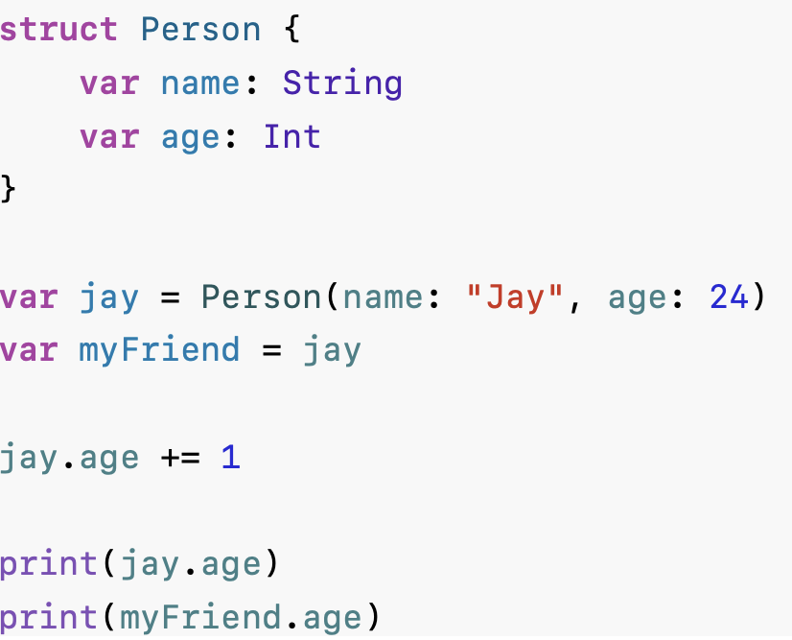
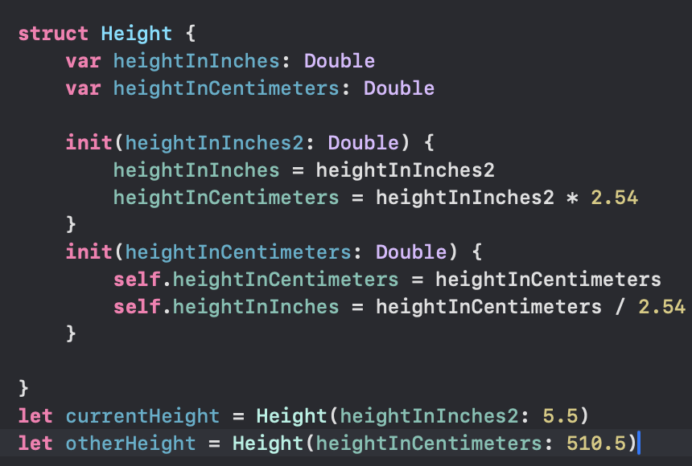
Struct Ex.
Excerpt From
Develop in Swift Fundamentals
Apple Education
https://books.apple.com/us/book/develop-in-swift-fundamentals/id6468967906
This material may be protected by copyright.

Slide 4
Definition of Classes
Classes are another helpful tool in swift very similar to structs. Classes are a data organization tool that allow inheritance, a way to define objects with parameters and functions from a superclass.
While both can be very helpful for organizing code, they are written slightly different. Classes often can be more complex than Structs.
Classes can have a base/superclass. Subclasses are attached to the superclass and inherit all of the superclass’s properties and methods. However, subclasses can change or replace features from the superclass while also creating their own new features separate of the superclass.
What defines a class as different from a struct is variables store a reference. A reference refers to the ability where variables will reference previously assigned values to a variable within an instance. These variables do not contain the value, but instead have the address or “reference” to where it is stored within RAM.

Slide 5
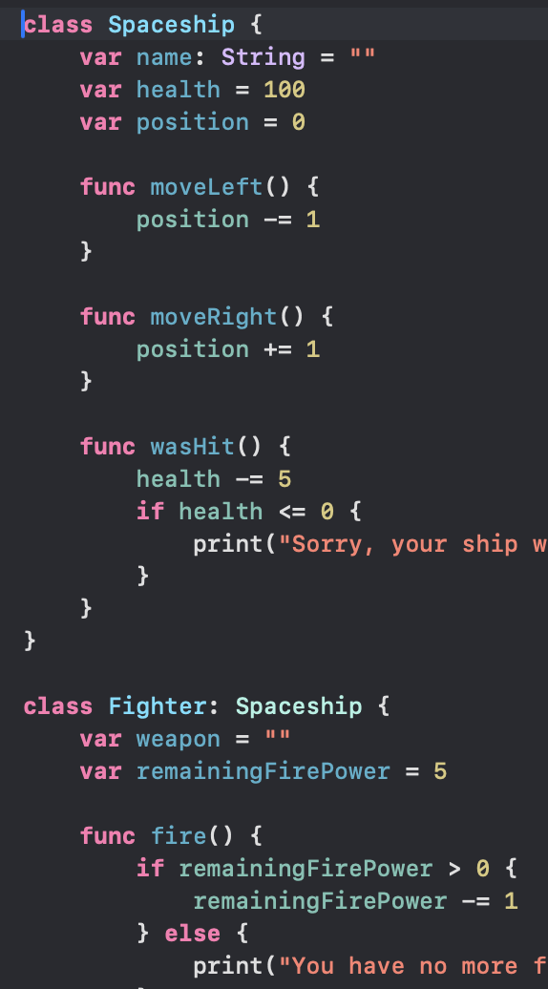
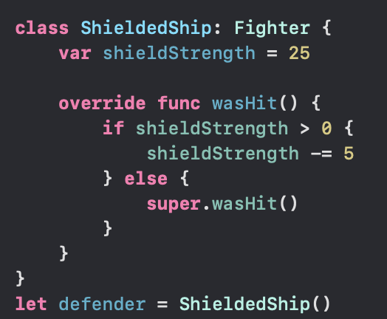
Classes Ex.

Slide 6
Both
Struct
Class
Organize Data & Functions
Inheritance
Free Init
Value Type
Made up of properties, inits, and methods
Reference Type
Defining a new type

Slide 7

When to use Struct
Always start with a struct. If you need class than switch, but other than that stick with struct.

Slide 8
When to use Class
It’s good practice to start with a struct until you need a feature of classes.
Start with a class when using frameworks due to many frameworks using classes.

Slide 9
Metaphors
Class:
A family where the parent represents the superclass and the children being the subclasses. All important information that the family needs is stored on the group schedule, like soccer practice being on Mondays and cleaning bedrooms on Saturday.
Struct:
A grandparent with dementia who lives alone. The grandparent can do everything on their own, but has trouble with remembering details. For ex: The grandparent’s child was named Robert, but Robert changed their name to Bobby, but Bobby is still Robert but the grandparent only remembers Robert and believes that Bobby is a different person.

Slide 10
Clarification for Robert & Bobby
var rStruct = SomeStruct(name: "Robert")
var bStruct = rStruct // rStruct and bStruct are two structs with the same value
bStruct.name = "Bobby"
print(rStruct.name) // "Robert"
print(bStruct.name) // "Bobby"

